Slide 1
Ease In and Ease Out
Some suggestions…

Slide 2
Constant velocity
This one is straight forward:
Distance = Velocity * time
So you can solve for time:
Time = Distance/Velocity
Or t = x/v

Slide 3
Non-constant velocity is trickier
This is non-linear, so you could get into “The World of Calculus” to calculate the entire result, or you could do it another way if the acceleration is constant during the ease in and ease out
Break into 3 parts:
Ease in (acceleration)
Constant velocity part
Ease out (deceleration)

Slide 4

Let’s look at the 1st part, ease in/acceleration
If you google “distance from constant acceleration” you’ll get a bunch of sites. Here’s a good one: https://openstax.org/books/university-physics-volume-1/pages/3-4-motion-with-constant-acceleration
This might look familiar from high school physics… 😢

Slide 5
Here are the 3 phases graphed with velocity and acceleration:
Velocity is constant here because acceleration is 0 (not changing the velocity)
Velocity is changing linearly here because of constant acceleration
Velocity
Derivative
Time
Acceleration is constant here
Acceleration
Acceleration = 0 here
Time

Slide 6
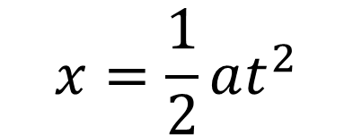
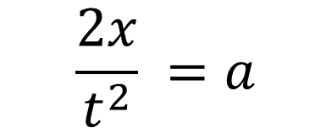
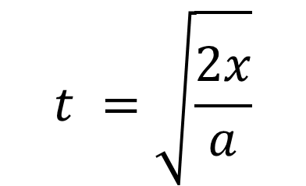
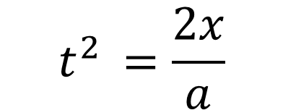
Here are the 3 phases graphed with velocity and acceleration:
X is position, v is velocity, a is acceleration
At start: x0, the starting position = 0
And v0, the starting velocity is also = 0
Time
$$t^{ }=\sqrt{\frac{2x}{a}}$$
$$x=\frac{1}{2}at^{2}$$
$$t^{2 }=\frac{2x}{a}$$
$${\frac{2x}{t^{2}}}^{ }=a$$

Slide 7
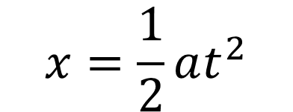
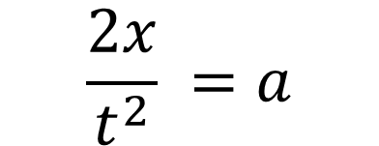
Example: x from 0 to 250 in 30 seconds
Velocity
Time = 30, EI/EO is 15%
Time → 15% of 30 seconds = 4.5 seconds
Distance → 15% of 250 units = 37.5 units
You’d need an acceleration of (2 * 37.5) / (4.5^2) = 75/20.25 = 3.7037… units/second^2
$${\frac{2x}{t^{2}}}^{ }=a$$
$$x=\frac{1}{2}at^{2}$$
Check: x = (3.7037 * 4.5^2)/2

Slide 8
Example: x from 0 to 250 in 30 seconds
Velocity
Time = 30, EI/EO is 15%
The sweet part is that the deceleration is the same, but negative: 3.7037…
And you can transition between these “parts” by using time or distance
Like when it passes time = 4.5 seconds OR Distance = 37.5 units, you set the acceleration to zero (0)
Then when you are at time = (30-4.5) = 25.5 OR distance = (250-37.5) = 212.5, you set the acceleration to -3.7037 and it should decelerate gradually to a stop
WARNING: it almost certainly won’t be exactly correct, like it will overshoot and/or be moving a little bit when it hits the “end” location. (but this might not be a “big deal” like if you are just flying a space ship around, can you even tell it’s off by a tiny amount?)

Slide 9
SLERP – same thing, but with angles
B
C
A

